Slide 1
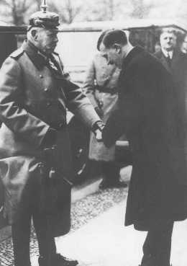
What do you see in the photo? How does this add to your knowledge of the Holocaust? What questions does this photo raise in your mind?
Notes:
Adolf Hitler, the newly appointed chancellor, greets German president Paul von Hindenburg. Berlin, Germany, January 30, 1933.
— Federation Nationale des Deportes et Internes Resistants et Patriots

Slide 2
Imagine what might be going on the sides of the photo - who is the photographer? Who is behind the photographer? Who might be in the background on any and all sides, observing?
Notes:
Adolf Hitler, the newly appointed chancellor, greets German president Paul von Hindenburg. Berlin, Germany, January 30, 1933.
— Federation Nationale des Deportes et Internes Resistants et Patriots

Slide 3
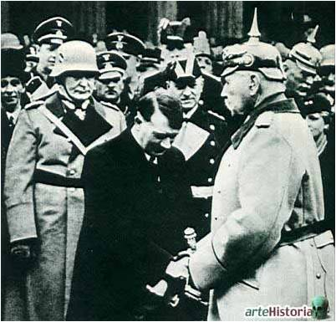
How does this photo change your ideas about the previous photo?

